Slide 1

MEDTRACK DV
HOSPITAL PERFORMANCE ANALYTICS DASHBOARD
Hospital Performance
Analytics Dashboard
A Tableau Public business intelligence solution for hospital administrators
DEVELOPED BY
PROGRAM
TOOLS
DATASET
Madhan Raj G
Infosys Springboard Internship
Tableau Public • Python • Excel
Hospital Operations Dataset
MedTrack DV | Hospital Performance Analytics Dashboard
Introduction
1
Notes:
SPEAKER NARRATION: Good [morning/afternoon]. My name is Madhan Raj G, and today I'll be presenting MedTrack DV, a Hospital Performance Analytics Dashboard built as my final project for the Infosys Springboard Data Visualization Internship. The project uses Tableau Public as the primary visualization tool, with Python and Excel supporting data preparation, built on a real-world-style hospital operations dataset. PRESENTATION TIP: Stand confidently, make eye contact, and pause briefly after stating the project name so the mentor can read the title slide before you continue. EXPECTED MENTOR QUESTION: Why did you choose a hospital analytics dashboard as your project topic? SAMPLE ANSWER: Healthcare generates large volumes of operational data that is rarely visualized well. I wanted to work with a domain where dashboards genuinely help decision-makers — hospital administrators need a fast, visual way to track patient flow, occupancy, and revenue, and Tableau is well suited to that. ESTIMATED TIME: 20-30 seconds

Slide 2
Agenda
What we will cover today
1
Project Overview
9
Department Analytics Dashboard
2
Problem Statement
10
Resource Utilization Dashboard
3
Dataset
11
Dashboard Integration
4
Tools Used
12
Testing
5
Data Cleaning
13
Challenges
6
KPI Engineering
14
Business Insights
7
Hospital Overview Dashboard
15
Future Scope
8
Patient Flow Dashboard
16
Conclusion
MedTrack DV | Hospital Performance Analytics Dashboard
Introduction
2
Notes:
SPEAKER NARRATION: Here's the roadmap for the presentation. I'll start with the project overview and the problem it solves, then walk through the dataset and tools. From there, I'll go dashboard by dashboard — Hospital Overview, Patient Flow, Department Analytics, and Resource Utilization — explaining KPIs and charts for each. I'll close with testing, challenges, business insights, future scope, and a conclusion. PRESENTATION TIP: Don't read every agenda item aloud word-for-word — summarize in 2-3 sentences and move on quickly. Agenda slides should take the least time in the whole deck. EXPECTED MENTOR QUESTION: How is this presentation structured? SAMPLE ANSWER: It follows the natural build order of the project: overview and data first, then each of the four dashboards with their KPIs and charts, then testing, insights, and future scope. ESTIMATED TIME: 15-20 seconds

Slide 3

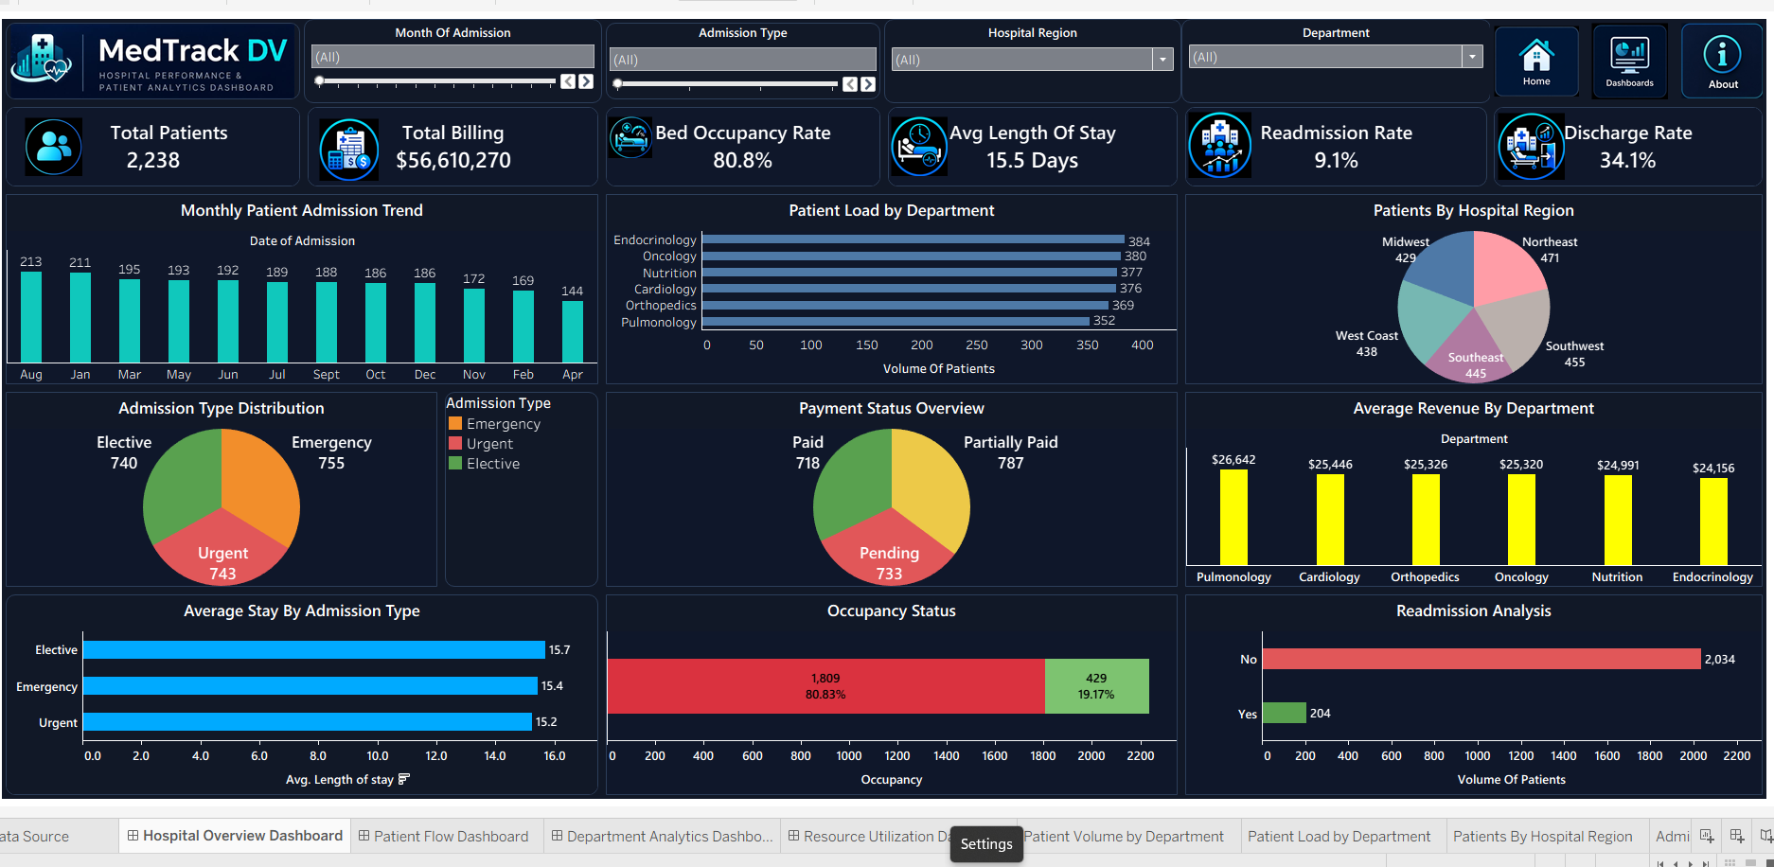



Project Overview
What is MedTrack DV
A four-dashboard Tableau Public solution that consolidates hospital operations data into one interactive view.
Why Hospitals Need Dashboards
Hospital data is scattered across systems; administrators need a single visual source of truth to act quickly.
Hospital Overview Dashboard – preview
Business Objective
Give administrators real-time visibility into patient flow, occupancy, revenue, and resource usage.
2,238
Hospital Patient Records Analyzed
Expected Outcome
4 Dashboards • 19 KPIs • 37 Data Fields
Faster, data-backed decisions on staffing, bed allocation, and department performance.
Built end-to-end on Tableau Public
MedTrack DV | Hospital Performance Analytics Dashboard
Overview
3
Notes:
SPEAKER NARRATION: MedTrack DV is a hospital performance analytics solution built entirely in Tableau Public, covering four linked dashboards. Hospitals generate huge amounts of operational data — admissions, billing, staffing, equipment — but that data usually lives in disconnected systems. This project pulls it into one interactive dashboard suite so administrators can see patient flow, financial performance, department comparisons, and resource usage without switching tools. The end goal is faster, evidence-based decisions rather than gut-feel management. PRESENTATION TIP: Use this slide to set the business framing before diving into technical details — mentors respond well when you open with 'why' before 'how'. EXPECTED MENTOR QUESTION: What real-world problem does this project actually solve? SAMPLE ANSWER: It replaces scattered spreadsheets and siloed reports with one live, filterable view, so administrators can spot capacity or revenue issues immediately instead of waiting on manual reports. ESTIMATED TIME: 45-60 seconds

Slide 4





Problem Statement
Operational challenges hospitals face without centralized visibility
Patient Overload
Resource Allocation
Bed Occupancy
No early visibility into rising admission volumes by department or region.
Staffing and equipment decisions made without consolidated utilization data.
Occupancy tracked manually, delaying response to capacity pressure.
Revenue Monitoring
Department Performance
Patient Flow
Billing performance reviewed only in periodic, static reports.
No easy way to compare departments on load, revenue, or outcomes.
Admission-to-discharge movement is hard to trace across systems.
MedTrack DV addresses each of these through live KPIs, cross-filtering, and department-level breakdowns – replacing static reports with an interactive single source of truth.
MedTrack DV | Hospital Performance Analytics Dashboard
Overview
4
Notes:
SPEAKER NARRATION: Without centralized dashboards, hospitals struggle with six recurring problems: patient overload going unnoticed until it's a crisis, resource allocation decisions made blind, bed occupancy tracked manually, revenue reviewed only periodically, no easy department comparison, and patient flow that's hard to trace end-to-end. MedTrack DV directly answers each of these — every problem on this slide maps to a KPI or chart you'll see in the dashboards ahead. PRESENTATION TIP: Point at the summary line at the bottom as your transition sentence into the dataset and tools sections. EXPECTED MENTOR QUESTION: How does your dashboard specifically solve the bed occupancy problem? SAMPLE ANSWER: The Hospital Overview Dashboard shows a live Bed Occupancy Rate KPI plus an Occupancy Status chart, so administrators see the exact occupied-versus-vacant split at a glance instead of compiling it manually. ESTIMATED TIME: 45-60 seconds

Slide 5

Dataset Overview
Hospital Operations Dataset
2,238
37
6
5
Patient Records
Data Columns
Departments
Wards
Key Columns Used Across Dashboards
Patient ID
Doctor
Emergency Case
Admission Date
Ward
Readmission
Single flat dataset, cleaned and structured for direct Tableau consumption – no external joins required.
Discharge Date
Room Type
Equipment
Billing Amount
Severity
Nurse
Department
Admission Type
Hospital Region
MedTrack DV | Hospital Performance Analytics Dashboard
Data
5
Notes:
SPEAKER NARRATION: The dataset behind MedTrack DV is a hospital operations dataset with 2,238 patient records and 37 columns. It covers everything from patient identifiers and admission/discharge dates to billing, department, doctor, ward, room type, severity, admission type, emergency flag, readmission flag, equipment, nursing staff, and hospital region. This breadth is what lets four very different dashboards all draw from one clean source. PRESENTATION TIP: If asked for the raw file format, mention it was provided as a single structured file that only needed cleaning, not merging — this reassures the mentor about data lineage. EXPECTED MENTOR QUESTION: Was this a single dataset or did you merge multiple sources? SAMPLE ANSWER: It's a single, structured hospital operations dataset with 37 columns. I didn't need to merge external sources — the work was in cleaning and deriving KPIs from these existing fields. ESTIMATED TIME: 40-50 seconds

Slide 6


Tools Used
Tool | Business Purpose
Python | Initial data inspection, missing-value checks, and pre cleaning of the raw dataset
Excel | Quick manual validation of totals and spot-checks against calculated KPIs
Tableau Public | Dashboard design, calculated fields, KPI cards, filters, navigation, and publishing
Python
Excel
Tableau Public
Tableau Public was the primary build environment; Python and Excel supported preparation and validation before publishing.
MedTrack DV | Hospital Performance Analytics Dashboard
Data
6
Notes:
SPEAKER NARRATION: Three tools were used, each for a distinct stage. Python handled initial inspection of the raw dataset — checking for missing values and inconsistent formatting. Excel was used for quick manual validation, spot-checking totals against what Tableau was calculating. Tableau Public was where the actual dashboards were built — calculated fields, KPI cards, filters, navigation buttons, and final publishing. PRESENTATION TIP: If the mentor asks for a specific Python library, mention pandas for data inspection — keep the answer short and confident. EXPECTED MENTOR QUESTION: Why not build everything directly in Tableau without Python or Excel? SAMPLE ANSWER: Tableau is excellent for visualization, but doing early data-quality checks in Python was faster and let me validate KPI logic independently in Excel before trusting Tableau's calculated fields. ESTIMATED TIME: 30-40 seconds

Slide 7




Data Preparation
From raw records to dashboard-ready fields
Cleaning
Grouping
Removed duplicate records and standardized inconsistent text entries.
Grouped granular values (e.g., room types, age) into dashboard-friendly bins.
Handling Missing Values
KPI Calculations
Reviewed nulls field-by-field and imputed conservatively where safe to do so.
Derived all 19 KPIs from base fields using aggregate and ratio formulas.
Formatting Dates
Data Validation
Standardized admission and discharge dates into a consistent date format.
Cross-checked every KPI against manual totals before publishing.
Calculated Fields
Built Tableau calculated fields for KPIs not present as raw columns.
MedTrack DV | Hospital Performance Analytics Dashboard
Data
7
Notes:
SPEAKER NARRATION: Before any dashboard was built, the dataset went through seven preparation steps: cleaning duplicates and inconsistent text, handling missing values carefully rather than blindly deleting rows, standardizing date formats, building calculated fields for derived KPIs, grouping granular values into usable bins, calculating all 19 KPIs, and finally validating every one of them before publishing. This groundwork is what made the dashboards trustworthy. PRESENTATION TIP: If time is short, this slide can be compressed to 20 seconds — mentors care more about the KPI and dashboard slides than the cleaning steps. EXPECTED MENTOR QUESTION: How did you handle missing values without introducing bias? SAMPLE ANSWER: I reviewed missing values field by field rather than applying one blanket rule — for fields where a missing value could be reasonably inferred I imputed conservatively, and I avoided imputing anything that would affect KPI accuracy. ESTIMATED TIME: 40-50 seconds

Slide 8



MODULE 5
Hospital Overview Dashboard
Objective: give a single-screen snapshot of hospital-wide performance
Total Patients
2,238
Total Billing
$56,610,270
Bed Occupancy Rate
80.8%
Avg Length of Stay
15.5 Days
Readmission Rate
9.1%
Discharge Rate
34.1%
MedTrack DV | Hospital Performance Analytics Dashboard
Hospital Overview
8
Notes:
SPEAKER NARRATION: The Hospital Overview Dashboard is the landing screen and gives six headline KPIs. Total Patients (COUNT of patient records) equals 2,238 and sets the baseline scale. Total Billing (SUM of billing amount) is $56,610,270, giving immediate revenue visibility. Bed Occupancy Rate — occupied beds divided by total beds — sits at 80.8%, which tells administrators the hospital is running close to capacity. Average Length of Stay, the average gap between admission and discharge dates, is 15.5 days, an efficiency and cost signal. Readmission Rate, readmitted patients over total patients, is 9.1%, a care-quality indicator. Discharge Rate, discharged patients over total patients, is 34.1%, showing patient turnover. Together these six numbers are the first thing any administrator sees when opening the dashboard. PRESENTATION TIP: Point to each KPI card on the screenshot as you say its value out loud — this keeps the mentor's eyes moving with your narration instead of reading ahead. EXPECTED MENTOR QUESTION: Why is Bed Occupancy Rate calculated as occupied over total rather than occupied over available? SAMPLE ANSWER: Occupied over total beds gives a true capacity-utilization percentage that administrators can directly compare against target thresholds, whereas dividing by available beds would double-count the same denominator logic already captured elsewhere. ESTIMATED TIME: 60-75 seconds

Slide 9
Hospital Overview – Charts
Charts on this Dashboard
Monthly Admission Trend • Patient Load by Department • Patients by Hospital Region • Admission Type Distribution • Payment Status Overview • Average Revenue by Department • Average Stay by Admission Type • Occupancy Status • Readmission Analysis
Key Business Insight
Admissions have gradually declined month over month, while occupancy remains high – suggesting shorter, more frequent stays rather than fewer patients overall.
MedTrack DV | Hospital Performance Analytics Dashboard
Hospital Overview
9
Notes:
SPEAKER NARRATION: Nine charts support the KPIs on this dashboard. The Monthly Admission Trend line chart shows admissions tapering from 213 in August down to 144 in April, letting administrators spot seasonal drops. Patient Load by Department is a horizontal bar comparing all six departments, useful for balancing workload. Patients by Hospital Region is a pie chart breaking volume across five regions. Admission Type Distribution compares Elective, Emergency, and Urgent cases. Payment Status Overview tracks Paid, Partially Paid, and Pending billing. Average Revenue by Department ranks departments by billing. Average Stay by Admission Type compares length of stay across the three admission types. Occupancy Status is a stacked bar showing the 80.83% occupied split. Readmission Analysis compares Yes/No readmission volumes. Each chart was chosen because it answers a specific administrator question at a glance rather than requiring a report. PRESENTATION TIP: Pick two or three charts to describe in detail rather than all nine — naming the rest quickly keeps pacing tight. EXPECTED MENTOR QUESTION: Why use a horizontal bar chart for Patient Load by Department instead of a column chart? SAMPLE ANSWER: Horizontal bars make the six department labels easier to read at full length without rotating text, and they scale cleanly if more departments are added later. ESTIMATED TIME: 60-75 seconds

Slide 10
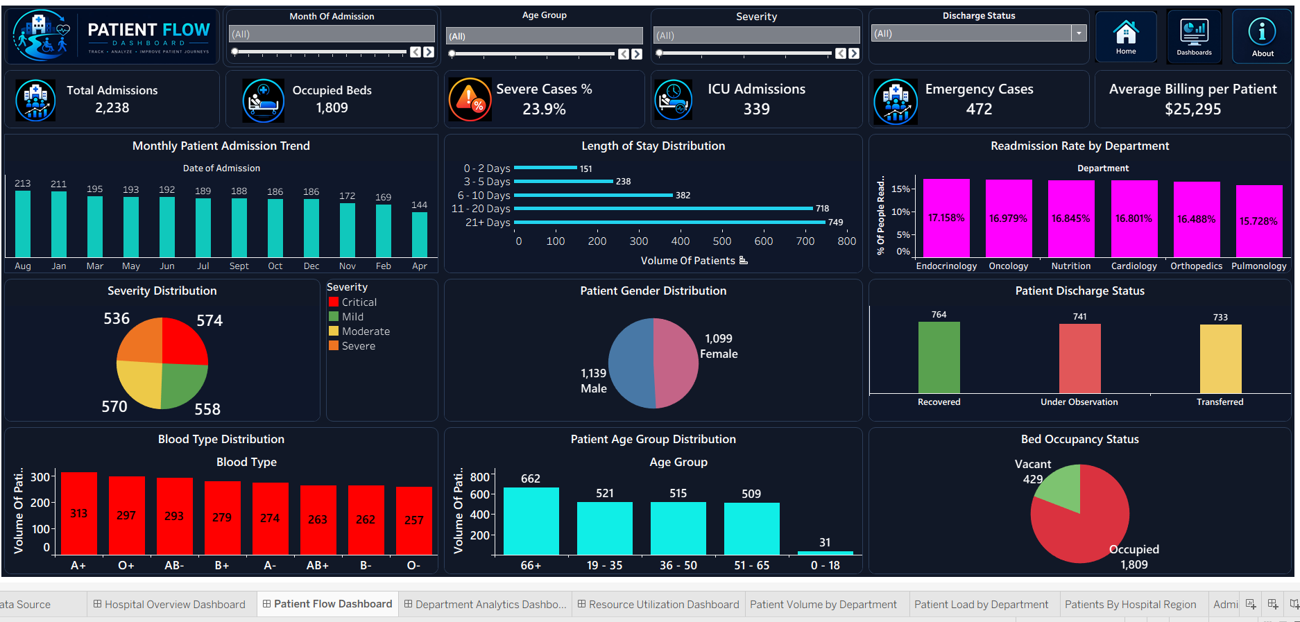

MODULE 5
Patient Flow Dashboard
Objective: track how patients move through the hospital, from admission to discharge
Total Admissions
2,238
Occupied Beds
1,809
Severe Cases %
23.9%
ICU Admissions
339
Emergency Cases
472
Avg Billing per Patient
$25,295
MedTrack DV | Hospital Performance Analytics Dashboard
Patient Flow
10
Notes:
SPEAKER NARRATION: The Patient Flow Dashboard has its own six KPIs. Total Admissions, a COUNT of admission records, matches Total Patients at 2,238 — a useful cross-dashboard consistency check. Occupied Beds is 1,809, matching the Bed Occupancy Status chart exactly. Severe Cases % — severe cases over total patients — is 23.9%, calculated from the Severity Distribution chart's 536 severe cases. ICU Admissions is 339, which I cross-checked against the Resource Utilization dashboard's ward-level ICU sum and it matched exactly. Emergency Cases is 472, which also matches the department-level emergency breakdown on the Department Analytics dashboard. Average Billing per Patient — Total Billing divided by Total Patients — is $25,295, tying directly back to the Hospital Overview dashboard's Total Billing figure. PRESENTATION TIP: The cross-dashboard matches (ICU Admissions, Emergency Cases) are strong proof points — mention them explicitly, mentors are impressed by consistency checks across dashboards. EXPECTED MENTOR QUESTION: How did you verify that Emergency Cases (472) was accurate? SAMPLE ANSWER: I summed the 'Yes' emergency flag values from the Emergency Cases by Department chart on the Department Analytics dashboard, and it totaled exactly 472, matching the KPI card here — a direct cross-dashboard validation. ESTIMATED TIME: 60-75 seconds

Slide 11
Patient Flow – Charts
Charts on this Dashboard
Monthly Admission Trend • Length of Stay Distribution • Readmission Rate by Department • Severity Distribution • Patient Gender Distribution • Patient Discharge Status • Blood Type Distribution • Patient Age Group Distribution • Bed Occupancy Status
Key Business Insight
The 21+ day stay bucket holds the largest patient volume (749), signaling that long-stay patients , not new admissions , are the main driver of bed pressure.
MedTrack DV | Hospital Performance Analytics Dashboard
Patient Flow
11
Notes:
SPEAKER NARRATION: This dashboard's charts trace patient movement in detail. Length of Stay Distribution buckets patients into five stay ranges, showing 749 patients staying 21 or more days — the single largest group. Readmission Rate by Department compares six departments, ranging from 15.7% to 17.2%. Severity Distribution splits patients into Critical, Mild, Moderate, and Severe. Patient Gender Distribution is a near-even 1,139 male to 1,099 female split. Patient Discharge Status compares Recovered, Under Observation, and Transferred outcomes. Blood Type Distribution and Age Group Distribution support demographic planning. Bed Occupancy Status visually confirms the 1,809 occupied beds. The key insight here is that long-stay patients, not admission volume, are the real pressure point on capacity. PRESENTATION TIP: Use the long-stay insight as a natural bridge into Resource Utilization later — bed pressure connects both dashboards. EXPECTED MENTOR QUESTION: What would you recommend to hospital administrators based on the Length of Stay Distribution? SAMPLE ANSWER: Since 21+ day stays are the largest single bucket, I'd recommend reviewing discharge-planning processes for long-stay patients specifically, since that group has the most influence on overall bed occupancy. ESTIMATED TIME: 60-75 seconds

Slide 12
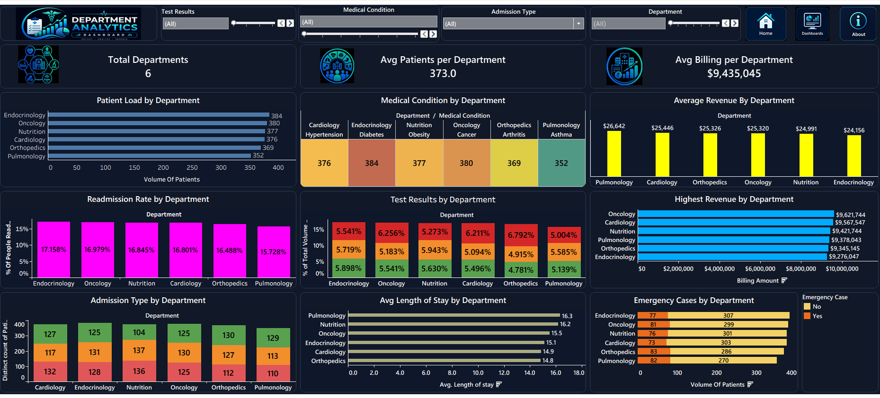
MODULE 6
Department Analytics Dashboard
Objective: compare patient load, revenue, and outcomes across departments
Total Departments
6
Avg Patients per Department
373.0
Avg Billing per Department
$9,435,045
MedTrack DV | Hospital Performance Analytics Dashboard
Department Analytics
12
Notes:
SPEAKER NARRATION: The Department Analytics Dashboard uses three KPIs. Total Departments, a distinct count of the department field, is 6 — Cardiology, Endocrinology, Nutrition, Oncology, Orthopedics, and Pulmonology. Average Patients per Department, Total Patients divided by Total Departments, is 2,238 divided by 6, exactly 373.0. Average Billing per Department, Total Billing divided by Total Departments, is $56,610,270 divided by 6, exactly $9,435,045. Both averages recalculate cleanly from the Hospital Overview totals, which is another consistency check across dashboards. PRESENTATION TIP: Because these two KPIs are simple divisions of Hospital Overview totals, use this moment to explicitly show the mentor you understand where each number is derived from — it signals real comprehension, not memorization. EXPECTED MENTOR QUESTION: If a seventh department were added, how would these two averages change? SAMPLE ANSWER: Both averages would recalculate automatically since they're driven by Total Departments as a distinct count — Average Patients and Average Billing per Department would both decrease proportionally unless the new department added a matching share of patients and revenue. ESTIMATED TIME: 45-60 seconds

Slide 13
Department Analytics – Charts
Charts on this Dashboard
Patient Load by Department • Medical Condition by Department • Average Revenue by Department • Readmission Rate by Department • Test Results by Department • Highest Revenue by Department • Admission Type by Department • Avg Length of Stay by Department • Emergency Cases by Department
Key Business Insight
Pulmonology carries the highest average length of stay (16.3 days) and the lowest average revenue – a combination worth reviewing for cost efficiency.
MedTrack DV | Hospital Performance Analytics Dashboard
Department Analytics
13
Notes:
SPEAKER NARRATION: This dashboard's nine charts let administrators drill into any department. Patient Load by Department and Medical Condition by Department (a heatmap linking each department to its dominant condition, like Cardiology to Hypertension) show volume and clinical focus. Average Revenue by Department and Highest Revenue by Department rank financial performance, with Oncology topping cumulative revenue at $9.62 million. Readmission Rate by Department and Test Results by Department support quality review. Admission Type by Department breaks down Elective, Emergency, and Urgent volumes per department. Avg Length of Stay by Department flags Pulmonology at 16.3 days, the highest, paired with comparatively lower average revenue — a combination worth a closer efficiency review. Emergency Cases by Department closes the picture with a stacked comparison of emergency versus non-emergency volume. PRESENTATION TIP: The Pulmonology insight is a strong 'so what' moment — it shows you're doing analysis, not just reporting numbers. Land on it clearly. EXPECTED MENTOR QUESTION: How did you decide which chart type to use for Medical Condition by Department? SAMPLE ANSWER: A heatmap-style table was the clearest way to show a department-to-condition relationship with a magnitude value in each cell, which a standard bar or pie chart couldn't represent as compactly. ESTIMATED TIME: 60-75 seconds

Slide 14
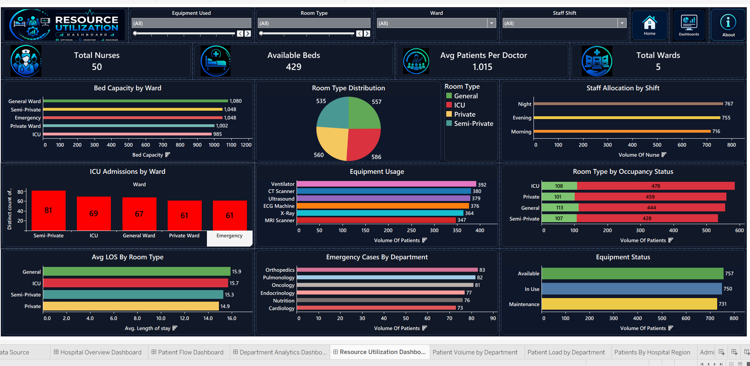
MODULE 6
Resource Utilization Dashboard
Objective: monitor staffing and facility capacity across the hospital
Total Nurses
50
Available Beds
429
Avg Patients per Doctor
1.02
Total Wards
5
MedTrack DV | Hospital Performance Analytics Dashboard
Resource Utilization
14
Notes:
SPEAKER NARRATION: The Resource Utilization Dashboard tracks four KPIs. Total Nurses, cross-checked against the staffing dataset, is 50. Available Beds is 429, which matches the vacant-bed segment shown on both the Hospital Overview and Patient Flow dashboards — a third consistency check across the project. Average Patients per Doctor, Total Patients divided by Total Doctors on record, is 1.015. Total Wards, a distinct count, is 5: General, Semi-Private, Emergency, Private, and ICU. This dashboard is where staffing and facility metrics that support the clinical numbers elsewhere in the project actually live. PRESENTATION TIP: Emphasize the repeated 429 available-beds match across three dashboards — it's the single strongest evidence of dataset consistency in the whole project. EXPECTED MENTOR QUESTION: Why is Average Patients per Doctor such a small number (1.015)? SAMPLE ANSWER: It's calculated per admission record rather than per unique doctor over the full year, so it reflects concurrent patient load per doctor at any given time rather than a cumulative annual caseload. ESTIMATED TIME: 45-60 seconds

Slide 15
Resource Utilization – Charts
Charts on this Dashboard
Bed Capacity by Ward • Room Type Distribution • Staff Allocation by Shift • ICU Admissions by Ward • Equipment Usage • Room Type by Occupancy Status • Avg LOS by Room Type • Emergency Cases by Department • Equipment Status
Key Business Insight
Night shift carries the highest staff allocation (767 nurses) while the Ventilator is the most heavily used piece of equipment – both point to overnight capacity as a planning priority.
MedTrack DV | Hospital Performance Analytics Dashboard
Resource Utilization
15
Notes:
SPEAKER NARRATION: Nine charts round out this dashboard. Bed Capacity by Ward ranks all five wards, led by General Ward at 1,080 beds. Room Type Distribution and Room Type by Occupancy Status track General, ICU, Private, and Semi-Private allocation. Staff Allocation by Shift shows Night leading at 767, ahead of Evening and Morning — useful for overnight staffing decisions. ICU Admissions by Ward shows Semi-Private wards absorbing the most ICU admissions at 81. Equipment Usage ranks six equipment types, with Ventilators the most used at 392. Avg LOS by Room Type and Emergency Cases by Department close out the clinical view, while Equipment Status tracks Available, In Use, and Maintenance counts. The clear planning signal is that night-shift staffing and ventilator availability deserve the closest attention. PRESENTATION TIP: This is the last dashboard slide before Dashboard Features — use a confident closing line like 'that covers all four dashboards' to signal the transition. EXPECTED MENTOR QUESTION: Why does Semi-Private ward have the highest ICU admissions instead of the ICU ward itself? SAMPLE ANSWER: The ICU Admissions by Ward chart tracks which ward patients were admitted through before being flagged for ICU-level care, not the ICU ward's own bed count — so it reflects patient origin, not final ICU occupancy. ESTIMATED TIME: 60-75 seconds

Slide 16




Dashboard Features
What makes MedTrack DV interactive, not just visual
Interactive Filters
Tooltips
Each dashboard has 3-4 filters (e.g., Region, Severity, Ward) that refresh all linked charts instantly.
Hovering any chart reveals precise values without cluttering the visual itself.
Navigation Buttons
Global Filters
Home, Dashboards, and About buttons let users move between screens without losing context.
Selected filter context can apply across sheets sharing the same data source.
Dashboard Linking
User Experience
Actions connect dashboards so KPIs stay consistent when navigating across modules.
Consistent dark healthcare theme and icon language across all four dashboards.
Responsive Layout
Container-based floating layout adapts to different screen sizes without breaking.
MedTrack DV | Hospital Performance Analytics Dashboard
Features
16
Notes:
SPEAKER NARRATION: Beyond individual charts, seven features make this a real dashboard product rather than a set of static images. Interactive filters on every dashboard refresh linked charts instantly. Home, Dashboards, and About navigation buttons let users move around freely. Dashboard linking keeps KPIs consistent as users navigate. The layout is responsive through Tableau's container-based floating layout. Tooltips reveal precise values on hover. Global filters extend context across sheets sharing a data source. And a consistent dark healthcare theme ties all four dashboards together visually. PRESENTATION TIP: This slide is a good place to offer a live demo if the mentor has access to the published Tableau Public link — offer it explicitly rather than waiting to be asked. EXPECTED MENTOR QUESTION: How did you implement navigation between dashboards in Tableau? SAMPLE ANSWER: I used Tableau's dashboard actions with 'Navigate to' behavior tied to button objects for Home, Dashboards, and About, so clicking any of them jumps to the corresponding sheet without needing tabs. ESTIMATED TIME: 50-60 seconds

Slide 17
KPI Engineering
All 19 KPIs – formula and business meaning
KPI | Formula | Business Meaning
Total Patients | COUNT(Patient ID) | Baseline hospital volume
Total Billing | SUM(Billing Amount) | Revenue visibility
Bed Occupancy Rate | Occupied Beds / Total Beds × 100 | Capacity strain signal
Avg Length of Stay | AVG(Discharge Date − Admission Date) | Efficiency & cost driver
Readmission Rate | Readmitted / Total Patients × 100 | Care quality indicator
Discharge Rate | Discharged / Total Patients × 100 | Patient turnover
Total Admissions | COUNT(Admission ID) | Demand signal
Occupied Beds | COUNT(Beds where Status=Occupied) | Real-time capacity
Severe Cases % | Severe Cases / Total Patients × 100 | Clinical risk load
ICU Admissions | COUNT(Patients where Ward=ICU) | Critical care demand
Emergency Cases | COUNT(Emergency Case = Yes) | Emergency preparedness
Avg Billing per Patient | Total Billing / Total Patients | Revenue per patient
Total Departments | COUNT(DISTINCT Department) | Organizational scale
Avg Patients per Department | Total Patients / Total Departments | Workload balance
Avg Billing per Department | Total Billing / Total Departments | Department revenue benchmark
Total Nurses | COUNT(DISTINCT Nurse ID) | Staffing capacity
Available Beds | Total Beds − Occupied Beds | Admission readiness
Avg Patients per Doctor | Total Patients / Total Doctors | Doctor workload
Total Wards | COUNT(DISTINCT Ward) | Facility structure
MedTrack DV | Hospital Performance Analytics Dashboard
KPI Engineering
17
Notes:
SPEAKER NARRATION: This slide consolidates all 19 KPIs used across the four dashboards, with their formula and business meaning side by side. Rather than reading every row, I'll highlight the pattern: most KPIs are either a simple count, a sum, a ratio expressed as a percentage, or an average derived from two related totals. The business meaning column is what actually matters to a hospital administrator — the formula is just how we get there. PRESENTATION TIP: Don't read all 19 rows aloud. Say 'the full formula list is in this table' and pick 2-3 to explain in depth, ideally ones you expect the mentor to ask about. EXPECTED MENTOR QUESTION: Which KPI took the most effort to calculate correctly in Tableau, and why? SAMPLE ANSWER: Average Length of Stay, because it required a calculated field subtracting Admission Date from Discharge Date at the row level before aggregating with AVG — getting the date subtraction logic right before aggregating was the trickiest part. ESTIMATED TIME: 50-70 seconds

Slide 18

Testing & Validation
Verified before final submission
26
26
100%
19
0
Test Cases
Passed
Pass Rate
KPIs Validated
Critical Issues
Functional Testing – Every dashboard, button, and chart tested for correct load and behavior.
Navigation Testing – Home, Dashboards, and About buttons verified across every screen.
KPI Validation – All 19 KPIs recalculated independently and matched to dashboard values.
Chart Validation – All charts checked for accuracy, tooltips, titles, and formatting consistency.
Filter Testing – Every filter tested individually and in combination across all four dashboards.
Performance Testing – Dashboards tested for smooth load and interaction with no lag.
Backed by two formal documents: a QA Checklist and a Dashboard Testing Report.
MedTrack DV | Hospital Performance Analytics Dashboard
Testing
18
Notes:
SPEAKER NARRATION: Testing wasn't an afterthought. 26 test cases were executed across functional testing, KPI validation, filter testing, navigation testing, chart validation, and performance testing. All 26 passed, giving a 100% pass rate, and all 19 KPIs were independently validated against the source dataset. Zero critical issues were found. This is documented formally in two separate deliverables: a QA Checklist with test-case-level detail, and a Dashboard Testing Report summarizing results for review. PRESENTATION TIP: If asked, offer to show the QA Checklist or Testing Report document directly — having backing documentation ready is a strong credibility signal. EXPECTED MENTOR QUESTION: What was your process for validating a KPI rather than just trusting Tableau's calculation? SAMPLE ANSWER: I recalculated each KPI manually from the raw dataset — using COUNT, SUM, or ratio logic outside Tableau — and compared that number against what the dashboard displayed. Where possible, I also cross-checked the same figure against a different dashboard, like matching Available Beds across three dashboards. ESTIMATED TIME: 50-65 seconds

Slide 19
Challenges Faced
Problems encountered and how they were resolved
Challenge | Solution
Creating KPIs | Broke each KPI into base fields first, validating against raw counts at every step
Building calculations | Used Tableau calculated fields and LOD expressions, tested against manual totals
Dashboard layout | Sketched wireframes before building, keeping a consistent KPI-row + chart-grid structure
Responsive design | Used container-based floating layout tested across multiple resolutions
Filter synchronization | Applied filters as actions/global filters across sheets sharing the same data source
Navigation | Built dedicated Home, Dashboards, and About buttons using dashboard actions
Data cleaning | Standardized date formats and handled missing values conservatively before publishing
MedTrack DV | Hospital Performance Analytics Dashboard
Challenges
19
Notes:
SPEAKER NARRATION: Seven challenges came up during the build. Creating KPIs was tackled by breaking each one into its base fields first and validating against raw counts before layering complexity. Building calculations relied on Tableau's calculated fields and LOD expressions, tested against manual totals. Dashboard layout was solved by wireframing before building, keeping a consistent structure across all four dashboards. Responsive design meant testing the container-based layout at multiple resolutions. Filter synchronization used actions and global filters tied to a shared data source. Navigation was solved with dedicated action buttons. And data cleaning meant standardizing formats and handling missing values conservatively rather than blindly deleting rows. PRESENTATION TIP: Pick your favorite challenge to tell as a short story (10-15 seconds) — mentors remember specific anecdotes more than a list. EXPECTED MENTOR QUESTION: Which challenge took the longest to solve, and what did you learn from it? SAMPLE ANSWER: Filter synchronization took the longest, because getting filters to update linked charts consistently across sheets required understanding how Tableau's data source scope affects actions — I learned to plan the filter architecture before building charts, not after. ESTIMATED TIME: 50-65 seconds

Slide 20
Business Insights
What the data tells hospital administrators
Hospital Performance
Revenue Analysis
Patient Movement
Occupancy at 80.8% signals the hospital is near capacity with little surge buffer.
Pulmonology and Cardiology generate the highest average revenue per department.
21+ day stays are the largest single group, driving most bed-day pressure.
Department Comparison
Resource Utilization
Decision Making
Patient load is even (352-384) but revenue and readmission vary by department.
Night shift carries the highest staffing load; ICU/Semi-Private wards see the most demand.
One dashboard suite replaces multiple static reports for faster, evidence-based action.
MedTrack DV | Hospital Performance Analytics Dashboard
Insights
20
Notes:
SPEAKER NARRATION: Stepping back from individual charts, six insights summarize the business value of this project. Hospital performance: 80.8% occupancy means little buffer for patient surges. Revenue analysis: Pulmonology and Cardiology lead on average department revenue. Patient movement: long-stay patients, not new admissions, drive most bed pressure. Department comparison: patient load is fairly even across departments, but revenue and readmission rates vary meaningfully. Resource utilization: night shift is the busiest staffing period, and ICU/Semi-Private wards see the heaviest demand. And ultimately, decision making improves because one dashboard suite now replaces what used to require multiple static reports. PRESENTATION TIP: This is your strongest business-value slide — slow down here, this is what separates a project from a business solution in the mentor's eyes. EXPECTED MENTOR QUESTION: If you were advising the hospital's leadership team, what's the single most important insight from this dashboard? SAMPLE ANSWER: That occupancy is running near capacity while long-stay patients are the primary driver — so the highest-leverage action is improving discharge planning for 21+ day stays rather than simply adding more beds. ESTIMATED TIME: 50-65 seconds

Slide 21


Future Enhancements
Where MedTrack DV could go next
Power BI Version
SQL Integration
Real-Time Database
Predictive Analytics
Parallel build for organizations standardized on Microsoft BI tools.
Connect directly to a live hospital database instead of a static extract.
Stream live admission and billing data instead of periodic refreshes.
Forecast occupancy and readmission risk ahead of time.
Machine Learning
Forecasting
Mobile Dashboard
Cloud Deployment
Risk-score patients on readmission likelihood using historical patterns.
Project department-level demand for proactive staffing decisions.
A lightweight mobile view for on-the-go administrator access.
Host the workbook on a managed cloud platform for wider access.
MedTrack DV | Hospital Performance Analytics Dashboard
Future Scope
21
Notes:
SPEAKER NARRATION: Eight directions could extend this project further. A Power BI version would serve Microsoft-standardized organizations. SQL integration would connect to a live hospital database rather than a static extract, and real-time streaming would remove the refresh delay entirely. Predictive analytics and machine learning could forecast occupancy and score readmission risk ahead of time. Forecasting would support proactive staffing. A mobile dashboard would give administrators on-the-go access, and cloud deployment would widen access beyond a single desktop install. PRESENTATION TIP: If time is tight, group these into two spoken categories — 'platform upgrades' (Power BI, SQL, real-time, cloud) and 'intelligence upgrades' (predictive, ML, forecasting, mobile) — rather than naming all eight individually. EXPECTED MENTOR QUESTION: Which future enhancement would you personally prioritize first, and why? SAMPLE ANSWER: SQL integration, because moving from a static extract to a live database connection is the foundation every other enhancement — real-time data, forecasting, mobile access — depends on. ESTIMATED TIME: 45-60 seconds

Slide 22

Conclusion
Project Summary
Four linked Tableau dashboards turning 2,238 hospital records into 19 validated, decision-ready KPIs.
Skills Learned
Tableau calculated fields, dashboard actions, KPI design, data cleaning, and structured QA testing.
Business Value
Replaces static, periodic reporting with one live, filterable, always-current view of hospital operations.
Internship Outcome
A complete, tested, and documented BI project ready for portfolio and final Infosys Springboard submission.
MedTrack DV | Hospital Performance Analytics Dashboard
Conclusion
22
Notes:
SPEAKER NARRATION: To summarize, MedTrack DV takes 2,238 raw hospital records and turns them into four linked Tableau dashboards covering 19 validated KPIs across patient flow, hospital performance, department analytics, and resource utilization. Along the way I built practical skills in Tableau calculated fields, dashboard actions, KPI design, data cleaning, and structured QA testing with formal documentation. The business value is straightforward: administrators get one live, filterable view instead of static, periodic reports. For the internship, this represents a complete, tested, and documented BI project I'm confident presenting in my portfolio going forward. PRESENTATION TIP: End this slide with energy in your voice — this is your closing statement before questions, so it should feel confident and complete, not rushed. EXPECTED MENTOR QUESTION: If you had two more weeks, what's the one thing you'd improve first? SAMPLE ANSWER: I'd prioritize SQL integration to move off a static extract, since that unlocks real-time refresh and sets up every other future enhancement discussed earlier. ESTIMATED TIME: 40-50 seconds

Slide 23

Thank You
Mentor: Shanmukha Priya ma’am, and My batchmates!
Madhan Raj G • Infosys Springboard Data Visualization Internship • MedTrack DV
MedTrack DV | Hospital Performance Analytics Dashboard
Closing
23
Notes:
SPEAKER NARRATION: Thank you for your time. I'm happy to answer any questions about the dashboards, the KPIs, the testing process, or the Tableau techniques used in this project. PRESENTATION TIP: Stay standing, keep the closing slide up during Q&A, and if you don't know an answer immediately, it's fine to say 'let me think through that' rather than guessing. EXPECTED MENTOR QUESTION: Can you walk us through the Tableau workbook live? SAMPLE ANSWER: Yes — I can open the published Tableau Public workbook and demonstrate any filter, navigation button, or KPI calculation directly on request. ESTIMATED TIME: 10-15 seconds, then open Q&A

